Slide 1
Solar Battery Monitoring
Presentation made by:
Abayahia Hamou Zinedine
Supervisor:
Pr Abdelhakim Khouas
June 2022
IGEE EX Inelec
Boumerdes

Slide 2
Purpose
Monitoring Solar Battery Health
Monitoring the voltage and current of the batteries.
Monitoring the batteries’ charge level (SOC).
Main goal
Achieving accurate voltage and current measurements.

Slide 3
Content
Introduction​
Background
Measuring Current and Voltage
State of Charge Estimation
Implementation​ and Results
Conclusion

Slide 4
1. Introduction
Why Monitor Battery Health?
Battery supplied systems often fail because of dying batteries.
Replacing dead batteries increases the maintenance costs greatly.
The batteries will continue to fail prematurely without a proper diagnosis of the problem.

Slide 5
1. Introduction
Determining Battery Health
Terminal voltage and current give us information about internal resistance and age.
State of Charge (SOC) gives us the amount of charges in the battery.

Slide 6
1. Introduction
What Will Be Discussed
Analog to Digital Converters (ADCs) and voltage dividers for voltage measurements.
Current sensor types.
Coulomb Counting and Open-Circuit Voltage method for SOC estimation.

Slide 7
2. Background
Defining ADCs
ADCs are systems which convert various analog signals such as audio signals to discreet digital signals which can be interpreted by a microcontroller.

Slide 8
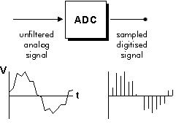
2. Background
ADC Function
ADCs convert their input signals into digtal values through successive approximation or Delta-Sigma modulation.
ADC Function

Slide 9
2. Background
Oversampling and Averaging
ADC measurements can often times be noisy and unreliable.
Oversampling and averaging consists of reducing that noise through taking multiple samples, adding them, and averaging them.

Slide 10
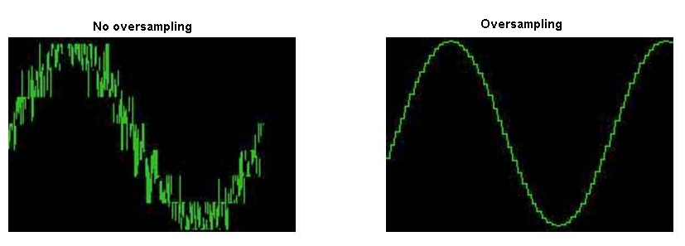
2. Background
Comparision between a regular output and an oversampled output

Slide 11
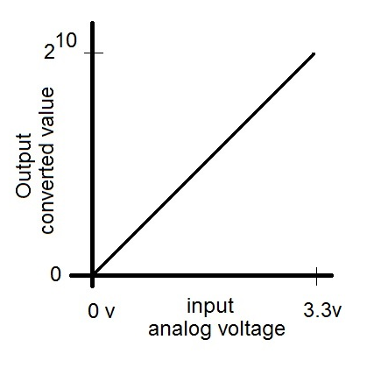
2. Background
ADC Linearity
An ideal ADC should have its output linear to its input voltage.
Some ADCs have non-linear regions.
Ideal 10 bit ADC Characteristic function

Slide 12
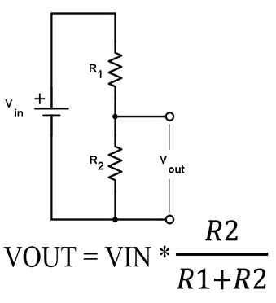
2. Background
Voltage dividers
We use voltage dividers to attenuate our input signal to a safe range for microcontrollers.
We also use them to bias our signal in the linear region of the ADC.
Voltage Divider Attenuation

Slide 13
2. Background
Resistive Current Sensors
They sense current through the voltage drop across a sense resistor placed in series with the load.
The sense resistor (Rsense) has very small resistance to avoid interfering with the load’s current draw.
The voltage across Rsense is amplified and measured through an ADC.

Slide 14
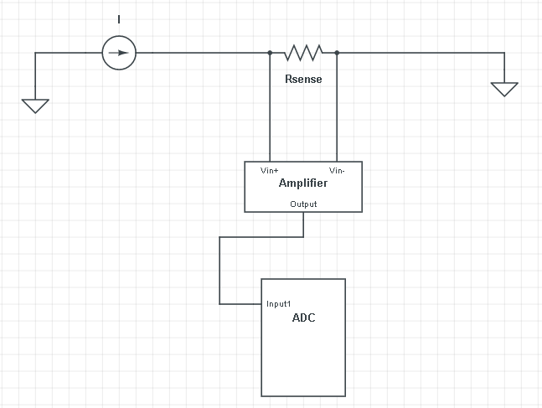
2. Background
Resistive Current Sensor Diagram

Slide 15
2. Background
Advantages of Resistive Current Sensing
Cheap and simple.
Very accurate.
Disadvantages of Resistive Current Sensing
Rsense adds a voltage drop near ground.

Slide 16
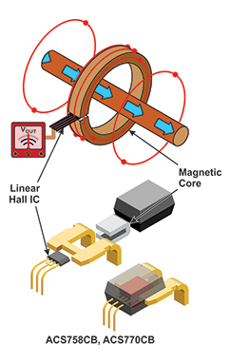
2. Background
Hall Effect Sensors
Current sensors that sense the magnetic field intensity caused by current flow.

Slide 17
2. Background
Advantages of Hall Effect Sensing
Galvanic isolation.
Disadvantages of Hall Effect Sensing
Inaccurate compared to resistive sensors.

Slide 18
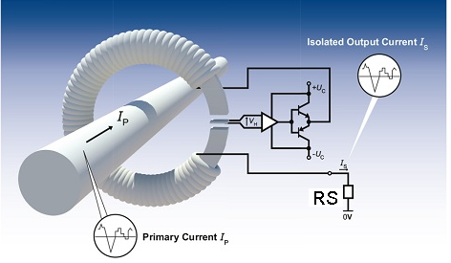
2. Background
Current Transformers (Hall compensated)
Current sensors that use faraday’s law to measure current , in addition to the hall effect.

Slide 19
2. Background
Advantages of Current Transformers
Galvanic isolation.
Very high accuracy under specific conditions.
Disadvantages of Current Transformers
Very expensive.
Its accuracy changes depending on temperature and magnetic offset.

Slide 20
3. Measuring Current and Voltage
Specifications
We need to monitor two 12 V solar batteries in series.
Voltage error should not exceed ±1%.
Current measurement error should not exceed ±2%.
We need a heatsink with thermal resistance 1.68 C°/W or less for the electronic load.
We use the ESP32 ADCs.

Slide 21
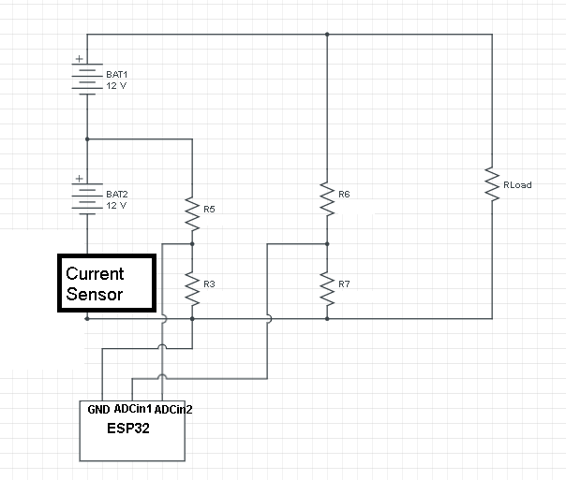
3. Measuring Current and Voltage
Design
We designed a circuit which measures current and voltage to test our current sensors’ accuracy.

Slide 22
3. Measuring Current and Voltage
Current Sensor Choice
We use the previous circuit to test which sensor is most suitable.
Available Sensors
INA219 resistive sensor
ACS758 Hall effect sensor
L A 100 P Current transformer.

Slide 23
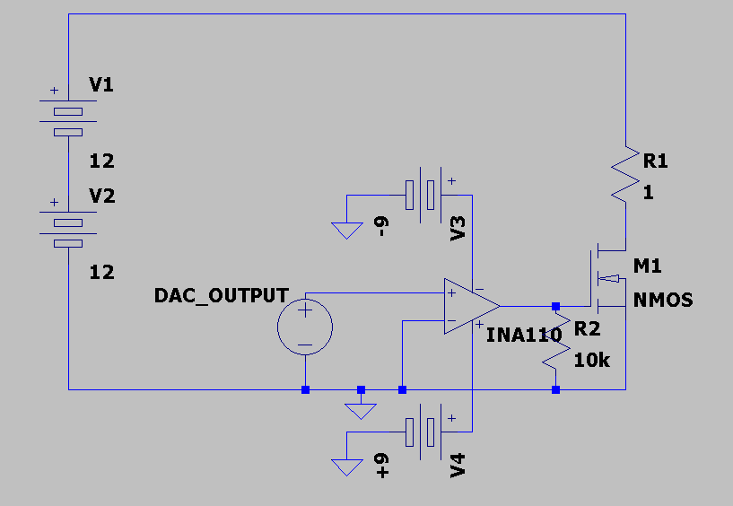
3. Measuring Current and Voltage
Electronic Load
We use an electronic load to control discharge current and test our current sensors.
We use the ESP32’s DAC to control its gate voltage.
Electronic Load Circuit

Slide 24
3. Measuring Current and Voltage
Heatsink for Electronic Load
The electronic load is dissipating a significant amount of power (up to 36W).
We need to test whether the heatsink we have is suitable.

Slide 25
4. State of Charge Estimation
Open Circuit Voltage (OCV)
We find battery voltage from translating terminal voltage.
Problems
We need to have the discharge curve for translating.
No current should be coming in or out of the battery.
Batteries need to be left to rest for at least 2 hours.

Slide 26
4. State of Charge Estimation
Coulomb Counting
We integrate the current to get the amount of charges remaining in the batteries.
Problems
We need to know the initial state of charge.
Integration errors accumulate.

Slide 27
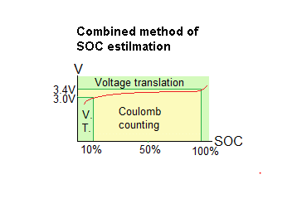
4. State of Charge Estimation
Solution
We use OCV when the battery is almost full or empty and Coulomb counting in the middle range.

Slide 28
5. Implementation and Results
Implementing the Current Testing Circuit
We use the electronic load to discharge at various currents and then measure them.
We verify the heatsink thermal resistance value by measuring its temperature variations with a multimeter.
We use ADS1115 ADC to sense the output of the current sensors ACS758 and LA 100P.

Slide 29
5. Implementation and Results
Implementing the Current Testing Circuit
We use a low pass filter for INA219 to decrease harmonics.
We use a multimeter to verify the accuracy of our measurements.

Slide 30
5. Implementation and Results
Implementing the voltage testing circuit
We connect our grounds together as physically close as possible to avoid ground offset.
We use the electronic load to discharge at various currents before measuring voltages.
We use a multimeter to verify the accuracy of our measurements.

Slide 31
5. Implementation and Results
Implementing the SOC Estimation
We perform a theoretical analysis of the SOC of two theoretical batteries.
We plug the theoretical characteristic of the batteries into our SOC estimation algorithm.
We use real batteries in order to get the current values.
We discharge the real batteries and compare the SOC value with the theoretical one.

Slide 32
5. Implementation and Results
Heatsink Calculation Results
Chosen heatsink is suitable (Rh(average) 0.211C°/W < 1.68C°/W ).
Thermal resistance measurement results
I(A) | Q(W) | Ta | Th | Rh
0 | 5.72 | 26 | 27 | 0.175
1 | 10.68 | 26 | 29 | 0.281
3 | 16.89 | 27 | 30 | 0.177

Slide 33
5. Implementation and Results
Current Measurement Accuracy Results
LA 100P average error -1.2% .
ACS758 available to me is a counterfeit chip (-36% error).
INA219 average error 0.7%, it is the most suitable current sensor.

Slide 34
5. Implementation and Results
Current Measurement Accuracy Results
ACS758 Accuracy Results
Imeas(A) | Isens(A) | Error (%) | Average Error(%)
0.359 | 0.575 | -60.16 | -36.50
0.259 | 0.3 | -15.83
1.99 | 2.99 | -50.25
4.1 | 4.91 | -19.75
LA 100P Accuracy Results
Imeas(A) | Isens(A) | Error (%) | Average Error(%)
4.66 | 4.63 | 0.64 | -1.20
1.4 | 1.42 | -1.42
0.4 | 0.41 | -2.5
1.3 | 1.32 | -1.53

Slide 35
5. Implementation and Results
Current Measurement Accuracy Results
INA219 Accuracy Results
Imeas(A) | Isens(A) | Error (%) | Average Error(%)
0.365 | 0.361 | 1.09 | 0.72
0.259 | 0.258 | 0.38
1.36 | 1.35 | 0.73
4.35 | 4.32 | 0.68

Slide 36
5. Implementation and Results
Voltage Measurement Accuracy Results
Average measurement error for voltage is is 0.48% for the first battery and 0.57% for the second battery in series.
Voltage Accuracy Test Results
I(A) | VBAT1(V) | VBAT2(V) | VBAT1a(V) | VBAT2a(V) | error1(%) | error2(%)
0 | 12.33 | 12.88 | 12.36 | 12.82 | 0.24 | -0.46
0.5 | 12.04 | 12.26 | 12.07 | 12.21 | 0.24 | -0.40
1 | 11.911977 | 12.03 | 11.91 | 11.94 | -0.016 | -0.75
3 | 11.33 | 11.08 | 11.5 | 11.01 | 1.47 | -0.63

Slide 37
5. Implementation and Results
Voltage Measurement Accuracy Results
The average error for VBAT1 measurements is 0.48% .
The average error for VBAT2 measurements is 0.57%.
Voltage accuracy meets our specifications (±1%).
Current measurement accuracy meets our specifications (±2%).
SOC estimation error is -0.0928 Ah per hour.

Slide 38
6. Conclusion
We designed a circuit which measures current and voltage reliably, in addition to SOC estimation.
Voltage dividers are a simple way of attenuating the input voltage without sacrificing accuracy significantly. (0.48% and 0.57% error figures were obtained for voltage measurement).
Resistive sensors are generally more accurate than Hall effect sensors (0.7% compared to -1.2% error).

Slide 39
6. Conclusion
The proposed design is reliable for obtaining voltage, current, and SOC for solar batteries.
Future work includes age and temperature compensation for SOC estimation.

Slide 40
Template Source Link (mandatory citation): https://poweredtemplate.com/solar-power-panels-on-a-field-powerpoint-template-52648/

